Slide 1

Graph Convolutional Networks in Recognition of Persuasive Faces in Online Media
ASPAI 2026 Palma de Mallorca Spain
Kristína Machová, Marián Mach, Peter Demeter
Institute of Artificial Intelligence, Technical University of Košice
June 24-26, 2026

Slide 2
Content
Research Frame
Problem Definition and Motivation
Data Description
GCN Model Training
Results of Experiments
Conclusions
Research Frame
Problem Definition and Motivation
Data Description
GCN Model Training
Results of Experiments
Conclusions

Slide 3
Research Frame
Research Frame
Problem Definition and Motivation
Data Description
GCN Model Training
Results of Experiments
Conclusions
Slovak Research and Development Agency
Contract no. APVV-22-0414: MODERMED
„Multimodal Detection of Toxic Behavior in Social Media“
  Unimodal toxicity detection in text content
    Types of toxicity - hate speech, offensive speech, fake news, des-information ...
    Methods – classic ML (NBayes, SVM), ensemble ML (RF, XGBoost), traditional deep learning (LSTM, BiLSTM, GRU, BiGRU, and combination with AM), transformer families (BERT, T5, GPT)
  Unimodal toxicity detection in images
    DeepFake, created by people, generated by AI, modified (synthetic or human origine)
    Methods – traditional deep learning (CNN, VGG-16, YOLOv11, MobileNet, DEnseNet, ConvNext), transformer (ViT – Visual Transformer)
    Detection of persuasive faces in connection with disinformation
    Methods – GCN (Graph Convolutional Networks)
  Toxicity detection in multimodal data (text, images, speech, videos)
    Methods – fusion (Early, Intermediate, Late), CLIP (Contrastive LIP), LaCLIP, ViLT, BLIP-2 (Boosting LIP)
  Detection of actors of online antisocial behaviour and their main attributes
    Trols, blocked users, adults in children's chat groups "chatrooms„
    Methods – NB, SVM, RF, MLP, CNN

Slide 4
Problem Definition and Motivation
Research Frame
Problem Definition and Motivation
Data Description
GCN Model Training
Results of Experiments
Conclusions
Social web technologies have created amazing things.
BUT
Endangering democracy, disrupting the functioning of society
Social networks benefits from constantly tracking people for advertising - business model of profitable disinformation to maintain our attention
SO
  some forms of regulation and limitation of harmful behaviour are needed
  help young people recognize disinformation, cyberbullying
GOAL
recognition of persuasive faces in online media
too much emphasis on trying to convince people about a product or in a political campaign
someone tries to convince us of something they may not even believe in themselves
an attentive listener can tell from body language and facial expressions that something is not right

Slide 5
Data Description
Research Frame
Problem Definition and Motivation
Data Description
GCN Model Training
Results of Experiments
Conclusions
The domain of research is represented by two datasets:
The first was dataset from Kaggle.com
obtaining faces representing various emotions: disgust, fear, happiness, sadness, surprise, as well as emotionally neutral faces
from these images we created two classes: a neutral class and second class of persuasive faces involving suitable emotions
The second dataset was from tlab.uchicago.edu/db-redirect-politicians-faces/
obtaining images of the faces of US senators and congressmen
Relevant data from these two sources were integrated into a joint dataset
neutral class – 6198 examples
class of persuasive faces – 9535 examples

Slide 6
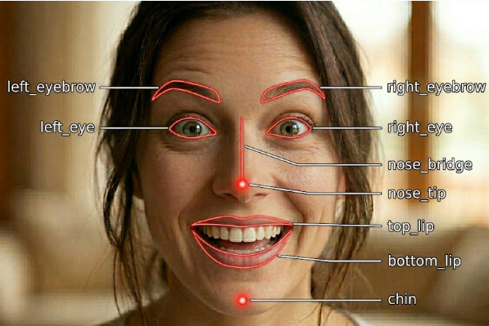
Data Description
Research Frame
Problem Definition and Motivation
Data Description
GCN Model Training
Results of Experiments
Conclusions
Data preprocessing for graph convolutional networks
to create facial feature graphs (face_recognition library)
to capture facial features (ace_recognition.face_landmarks )
Create graph from observed features

Slide 7
Data Description
Research Frame
Problem Definition and Motivation
Data Description
GCN Model Training
Results of Experiments
Conclusions

Slide 8
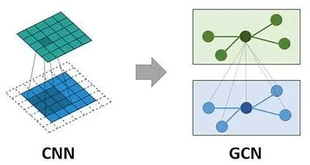
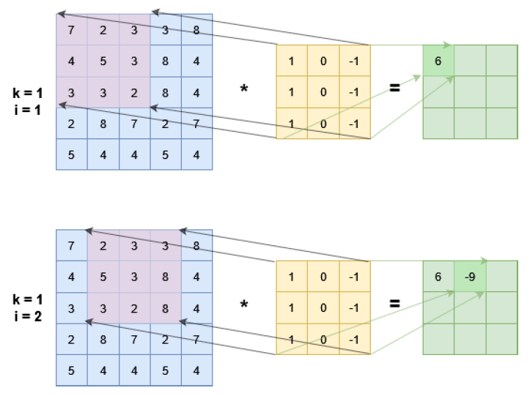
GCN Model Training
Research Frame
Problem Definition and Motivation
Data Description
GCN Model Training
Results of Experiments
Conclusions
Graph Convolutional Networks (GCN)
GCNs are a special type of convolutional neural networks that work with input data in the form graphs
Convolution in the case of graph data is applied in the form of a graph Fourier transformation
Difference between classic convolutional neural networks and GCN

Slide 9
GCN Model Training
Research Frame
Problem Definition and Motivation
Data Description
GCN Model Training
Results of Experiments
Conclusions
Graph Convolutional Networks (GCN)
The basic principles of the GCNConv layer include:
Aggregation: Aggregation functions (such as sum, mean, or max) are used to merge information from multiple neighboring nodes into a single vector
Node state update: After aggregating neighboring information, the new node state is calculated by combining its original state and the aggregated information
Recursive application: The aggregation and update process can be applied multiple times (i.e., across multiple layers of GCNconv), allowing the model to obtain information from progressively larger neighborhoods of nodes
Illustration of the principle of GCN

Slide 10
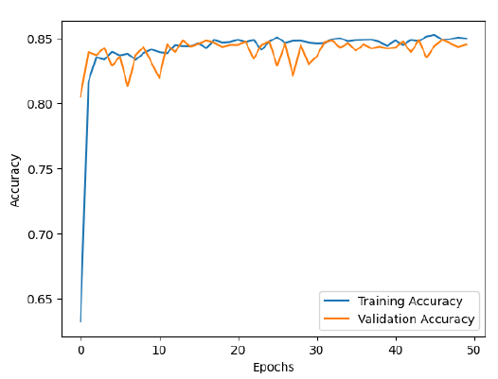
GCN Model Training
Research Frame
Problem Definition and Motivation
Data Description
GCN Model Training
Results of Experiments
Conclusions
The Architecture of GCN included:
pooling layers for feature extraction (GolbalAvaragePooling1D layer – GAP 1D)
fully connected layers (two hidden GCN layers with hyperparameter settings: 32, 64, 128, 256, and 512)
Sigmoid output layer for binary classification
number of epochs 50 and a batch size of 32
Adam optimization function
learning rate hyperparameter equal to 0.01
                Learning curve at a learning rate =0.01 for GCN training
Model | GCNConv1 | GCNConv2 | Output
7 | 32 | 64 | GAP 1D+Sigmoid
12 | 64 | 256 | GAP 1D+Sigmoid
22 | 128 | 64 | GAP 1D+Sigmoid
20 | 256 | 128 | GAP 1D+Sigmoid
17 | 256 | 512 | GAP 1D+Sigmoid
19 | 512 | 256 | GAP 1D+Sigmoid

Slide 11
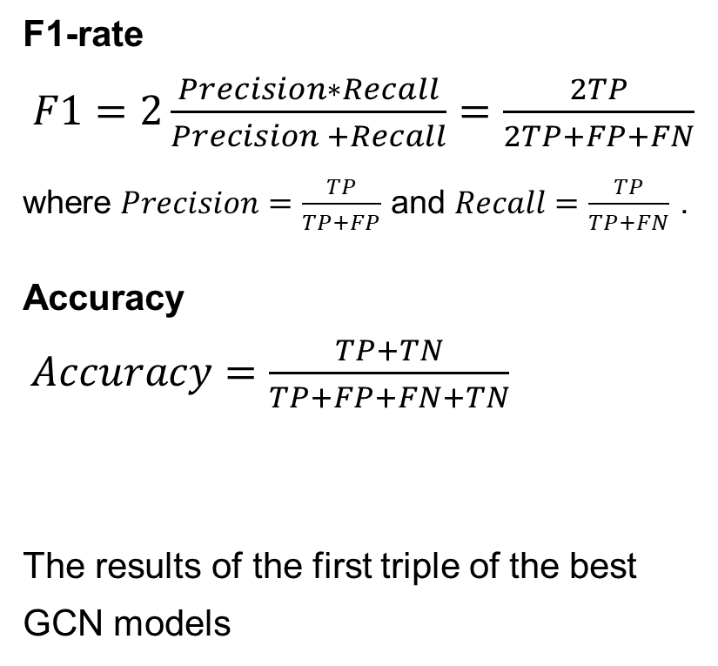
Results of Experiments
Research Frame
Problem Definition and Motivation
Data Description
GCN Model Training
Results of Experiments
Conclusions
Measures of experiments
F1-rate
$F1=2\frac{Precision∗Recall}{Precision +Recall}=\frac{2TP}{2TP+FP+FN}$
where $Precision=\frac{TP}{TP+FP}$ and $Recall=\frac{TP}{TP+FN}$ .
Accuracy
$Accuracy=\frac{TP+TN}{TP+FP+FN+TN}$
The results of the first triple of the best
GCN models
 |  | Model 7 | Model 12 | Model 22
B=16 | Acc | 0.8453 | 0.8264 | 0.8480
 | F1 | 0.8350 | 0.8051 | 0.8379
B=32 | Acc | 0.8492 | 0.8476 | 0.8472
 | F1 | 0.8390 | 0.8348 | 0.8342
B=64 | Acc | 0.8433 | 0.8468 | 0.8421
 | F1 | 0.8306 | 0.8354 | 0.8348
B=128 | Acc | 0.8260 | 0.8445 | 0.8476
 | F1 | 0.8214 | 0.8354 | 0.8363
B=256 | Acc | 0.8390 | 0.8464 | 0.8409
 | F1 | 0.8313 | 0.8350 | 0.8322

Slide 12
Results of Experiments
Research Frame
Problem Definition and Motivation
Data Description
GCN Model Training
Results of Experiments
Conclusions
The results of the second triple of the best GCN models
 |  | Model 20 | Model 17 | Model 19
B=16 | Acc | 0.8445 | 0.8464 | 0.8449
 | F1 | 0.8378 | 0.8341 | 0.8312
B=32 | Acc | 0.8468 | 0.8492 | 0.8495
 | F1 | 0.8361 | 0.8397 | 0.8361
B=64 | Acc | 0.8433 | 0.8421 | 0.8476
 | F1 | 0.8349 | 0.8402 | 0.8402
B=128 | Acc | 0.8433 | 0.8457 | 0.8457
 | F1 | 0.8342 | 0.8380 | 0.8342
B=256 | Acc | 0.8425 | 0.8496 | 0.8468
 | F1 | 0.8346 | 0.8389 | 0.8368

Slide 13
Conclusions
Research Frame
Problem Definition and Motivation
Data Description
GCN Model Training
Results of Experiments
Conclusions
GCNs have proven to be a suitable tool for building detection models in the field of synthetic image recognition.
The experiments were conducted using data for the recognition of artificially convincing faces (best result Accuracy=0.8496).
Various settings for hidden layers, error optimization, and regularization functions and hyperparameters were tested.
In the experiments, two GCN layers were used. In the future, it would be advisable to expand the GCN architecture with additional GCN layers.
GCN models have the potential to be deployed as a supporting or auxiliary tool in detecting persuasive faces for the purpose of regulating the number of frauds or manipulative content on social networks.

Slide 14
THANK YOU FOR YOUR ATTENTION
kristina.machova@tuke.sk

Slide 15
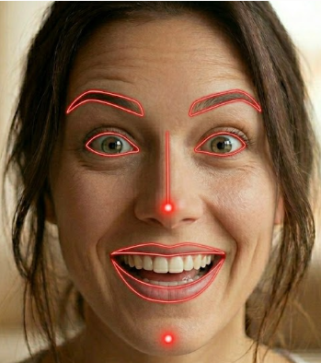
Conclusions and discussion

