Slide 1
Data Mining Methods in Web Analysis
prof. Ing. Kristína Machová, PhD.

Slide 2
Content
Machine learning
Decision trees
Ensemble learning
Bagging
Boosting
Random forests
Applications of machine learning
Sentiment analysis
Authorities and trolls identification

Slide 3
Machine Learning
task for learning
Learning algorithm
Classification task (assigning of an object to a class)
Version space (concepts definitions and relations between them)
Feature space
Sequence task (searching for a sequence of steps to aim)
State space
Representation of Output/Input –
Training set, Testing set
Version Space Search
Decision Trees
Naive Bayes Classifier
SVM Support Vector Machines
Controlled learning
Uncontrolled learning

Slide 4
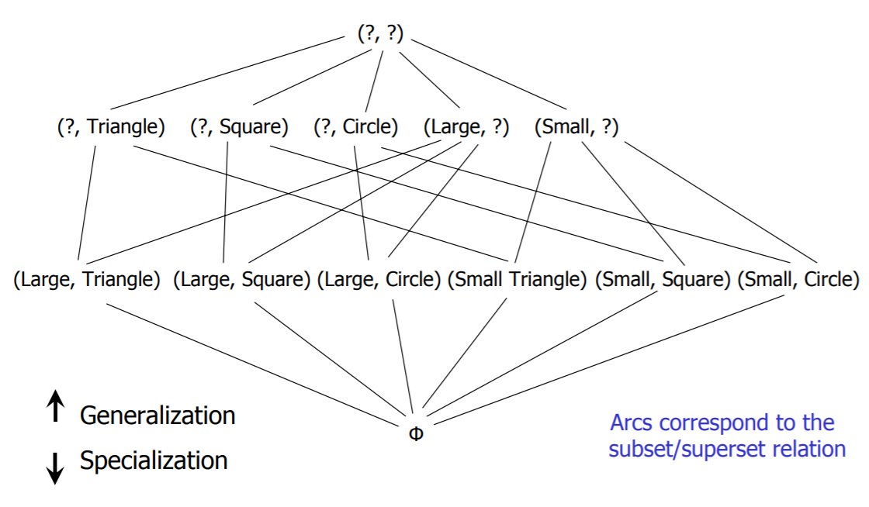
Machine learning
Versions space

Slide 5
Machine learning
Feature space

Slide 6
Machine learning
Machine Learning

Slide 7
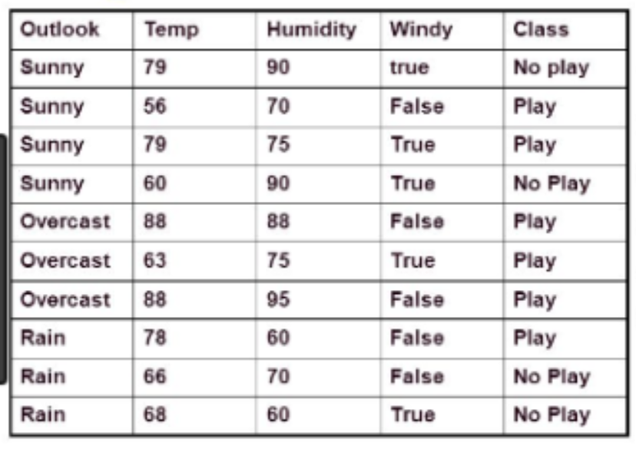
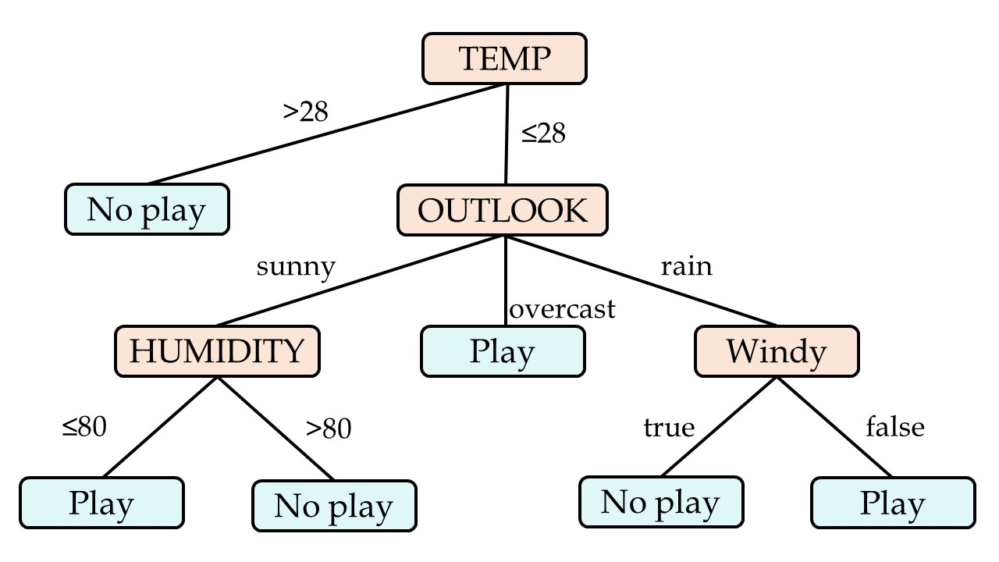
Decision Trees
ML- DT

Slide 8
Decision Trees
Representation:
High illustrative and interpretive – user acceptance
Acyclic graph – tree
Nodes:
Leaf nodes represent classes (results of a classifying)
Root and intermediate nodes - testing attributes
Edges represent values of testing attributes
Using:
IF a new example fulfil all conditions on the journey from the root node to a leaf node,
THAN the example is classified to the class of the given leaf node

Slide 9
Decision Trees Induction
Application of an approach „Separate and Conquer“
Ending Condition (EC)
perfect classification – each subspace contains only examples of one – the same class
non-perfect classification - each subspace contains eg. 90% examples of one class
General algorithm:
IF EC is fulfil for each subspace THEN End
ELSE
Choose a subspace with examples of different classes
Select still unused testing attribute TA
Split the subspace to other subspaces according values of TA

Slide 10
Decision Trees – ID3
Algorithm ID3 (Iterative Dichotomizer)
Ross Quinlan, 1979
Performs the perfect classifying
Non-incremental
Selection of TA – Shannon theory of information
Decreases entropy H, increases information gain IG
Generate the minimal tree – conditions:
un-contradict examples
un-redundant examples
un-depending attributes

Slide 11
Decision Trees - C4.5
Ross Quinlan, 1993
Modification of algorithm ID3
Non-incremental induction
Attributes:
discrete (nominal, binary)
continuous (real, integer numbers)
Ratio Information Gain (IG_{r})
New possibilities – to process:
continuous attributes
un-known values of attributes

Slide 12
Decision Trees – RIG
ID3 prefers the selection of testing attributes with more values
C4.5 solution – normalization using the ratio entropy H_{r} and the ratio information gain IG_{r}
Ration Entropy:
Increases with the number of branchs of a tree
Leads to the decision tree smaller in width

Slide 13
Decision Trees – Continuous Attributes
Values of a continuous attribute are ordered
Threshold value is computed for each pair of neighbor values as the arithmetic mean (average)
There are m-1 thresholds for m values of the attribute
We need to select one threshold for dividing space of examples into two sub-spaces
The threshold with maximal ratio information gain IG_{r} is selected
The space is divided into two subspaces according selected threshold:
First subspace - examples with attribute values less then the selected threshold
Second subspace – greater then the threshold

Slide 14
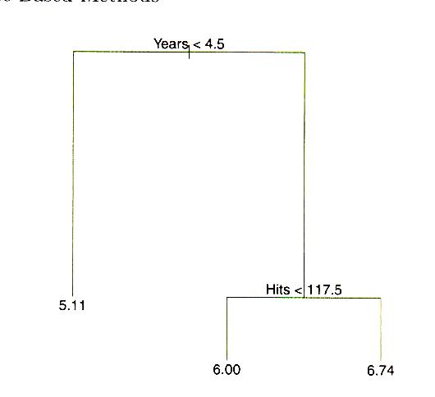
Decision Trees – Continuous Attributes
Prediction of salary
to three classes:
Low
Good
Very good
YEARS – number of years
of playing basketball
HITS – number of hits
Left branche <
Right branche ≥
Discrete and continuous
attributes can be combined.
LOW
GOOD
VERY GOOD

Slide 15
Ensemble Learning
Too small or less quality training set (irrelevant attributes, non – typical examples of class)
Weak classifier – low effectivity
Various samples of a training set are formed
On each sample, one particular weak classifier is learned
The result classification is created by the voting among all particular classifiers
Stacking
Bagging
Boosting
Random forests

Slide 16
Ensemble Learning – Bagging
Bootstrap AGGreatING [Breiman, 1994]
Forms m=1...M different samples of TS
Particular classifier is learned using a ML method H_{m}:–> {-1,1} a document $∈$D is(1)/is not(-1) classified to a class $∈$ C
Voting of particular classifiers is modeled by the formula below (α_{m} enforced influence of more precise classifiers on the result prediction):

Slide 17
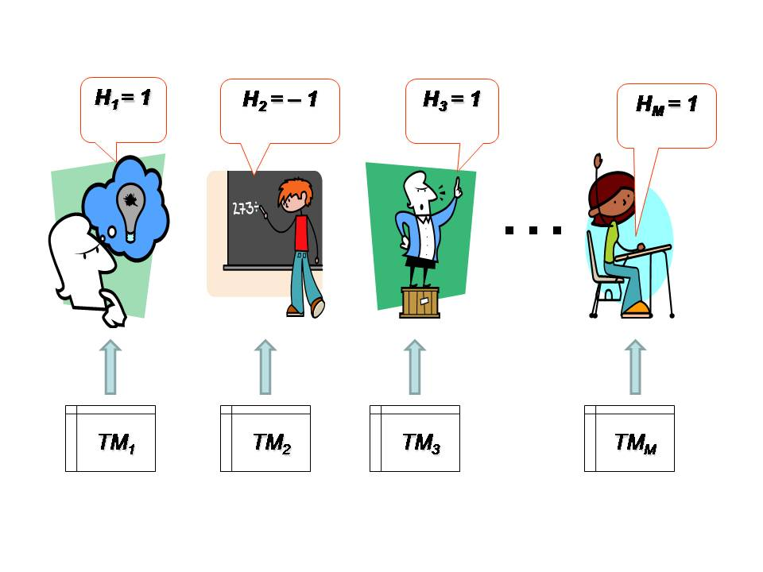
Ensemble Learning – Bagging

Slide 18
Ensemble Learning – Bagging
Bagging like strategies:
Disjoint partitions – each example only once, each subset creates 1/M part of an original TS
Small bags – random selection with replication
No replication small bags
Disjoint bags – in each subset 1/M, at least one randomly selected element is repeated, number of replications in each subset is the same
Original TS | A B C D E F G H I J K L M N O P
Disjoint partitions | A B C D | E F G H | I J K L | M N O P
Small bags (SB) | A C H L | B P L P | D I O H | K C F K
No replication SB | A C H L | O P B N | D I J E | K G F M
Disjoint bags | A B C D C | E F G H E | I J K L J | M N O P O

Slide 19
Ensemble Learning – Boosting
Boosting is an improved bagging [Schapire-Singer, 1999] based on the weighting of training examples
Forms m=1...M samples from the original TS
Samples differ only in weights of training examples
On every sample, weak classifier is trained H_{m}:–> {-1,1} using the same selected algorithm of ML
In every iteration:
weights of wrong/right classified examples are increased/decreased
modified sample is used for learning of the new classifier
Error driven ensemble learning – better results
Result of classification is the result of voting of particular classifiers (similar as in the bagging)

Slide 20
Ensemble Learning – Random Forests
Random Forests [Breiman, 2001] is a modification of the bagging
EL is based exceptionally on the decision tree ML method
Generates a set of de-correlated trees – forest of trees
Ensemble classifier
averages results of classifying of particular decision trees (regression DT)
creates the result of voting by particular classifiers DTs (classification DT)
Particular classifiers have to be independent (de-correlated) – random selection of a subset of attributes for every tree
Independent trees can be generated in parallel process
Random selection of training subset of training set for generation of every decision tree

Slide 21
Ensemble Learning – Random Forests
The random forests is a fast and highly precise approach – often used
Initialization faze – setting parameters:
number of decision trees in the model
number of randomly selected attributes in every tree
Within selection of the testing attribute in a node of generated tree - m attributes from whole number of p attributes are taken into account
One attribute from m attributes is selected
Within another sub-node different subset of m attributes is considered
One attribute is selected again

Slide 22
Ensemble Learning – Random Forests
Within every splitting of the space of training examples it is forbidden to use some attributes (unselected for subset of m attributes) – Why? Irrational?
IF there is one strong predictor in a group of slightly strong predictors THEN the strong predictor will be used for generation of all trees
Leads to similar trees - strong correlation of the trees
Averaging of the forest of highly correlated trees will not bring any benefit compared to using only one tree
Principle of de-correlation of trees – the probability of the selection of a strong predictor will be only (p-m)/p – other predictors will have more chance

Slide 23
Ensemble Learning – Random Forests
Main difference between the random forest and the bagging is the selection of a subset of m predictors
IF m=p THEN the random forest is equal to the bagging
Less value m leads to a more reliable random forest (mainly in the case of many correlated predictors
It is easier to train the random forest then tune the boosting
Popular, in more softwer packages of ML

Slide 24
Ensemble Learning - Comparison
Ensemble Learning increases the precision of a classification providing a voting of the set of weak classifiers (strong classifier do not need to rejoice)
Cons:
loss of a clarity
result of the learning is less illustrative
increasing of a computational complexity
Achieve results prefer boosting before bagging
Error driven ensemble learning in the boosting not only refines results but also accelerates the learning
Random forests do not require much tuning
They achieve only 4,88% of the classification error (bagging 5,4%).
They can not be over-learned

Slide 25
Applications of Machine Learning
Labeled trainig set – any machine learning method can be used
D | marvelous | reliable | never | totally | conforming | very | satisfied | really | mad | Class
1 | W₁₁ | W₁₂ | 0 | 0 | 0 | 0 | 0 | 0 | 0 | Positive
2 | 0 | 0 | W₂₃ | 0 | 0 | 0 | 0 | 0 | 0 | Negative
3 | 0 | 0 | 0 | W₃₄ | W₃₅ | 0 | 0 | 0 | 0 | Positive
4 | 0 | 0 | 0 | 0 | 0 | W₄₆ | W₄₇ | 0 | 0 | Positive
5 | 0 | 0 | 0 | 0 | 0 | 0 | 0 | W₅₈ | W₅₉ | Negative
This mobile is marvelous, its functioning is reliable.
Never buy this mobile.
This mobile is totally conforming.
I am very satisfied with my mobile.
It really drives me mad.
Binary representation 1 or 0
Vector representation W_{ij}
preprocessing using
TF-IDF
weighting scheme
Lexical profile
is really big

Slide 26
Applications of Machine Learning
Vector representation – of texts
reviews – short documents d_{i} contain terms (words) t_{j} with weight w_{ij}

Slide 27
Applications of Machine Learning
Labeled trainig set – has to contain CLASSES definition
Class | Class | Class | Class | Class | Class
Positive | 3 | Hapiness | Toxically | Authority | Troll
Negative | 2 | Sadness | Non-toxically | Non-authority | Non-troll
Positive | 1 | Surprise
Positive | -1 | Fear
Negative | -2 | Disgustt
Negative | -3 | Anger
opinion degree
troll reviews recognition
troll identifying
opinion polarity
emotions classifying
authority identification
SA – Sentiment Analysis

Slide 28
Applications of Machine Learning
authority identification
opinion polarity
emotions classifying
troll identifying
opinion degree
troll reviews recognition
learning from features of a reviewer
attributes (predictors) has to be defined
learning from short texts

Slide 29
Applications of Machine Learning
Authority Identification – attributes definition
NC is the number of reviews
ANR is the average number of reactions on one review
AL is the average number of all layers, on which the comments are situated
NCH is the number of characters, which represents the length of
K is karma of a contributor in the form of a number from 0 to 200
AE is the average evaluation of the comment - number from 0 to 80.

Slide 30
Applications of Machine Learning
Troll identifying – attributes definition ?
Abusive troll
Insistent troll
Troll, who controls the grammar
Always injured troll
Troll, who knows everything
Troll, who is beyond the theme
Troll, who is a continuous spamer

